Slide 1
Implementation of K-Means and K-medoid clustering algorithm.
Practical 5

Slide 2
K-means clustering algorithm
K-means is a popular unsupervised machine learning technique that allows the identification of clusters (similar groups of data points) within the data.
Will cover k-means clustering in R using tidymodels, ggplot2 and ggmap. We'll cover:
how the k-means clustering algorithm works
how to visualize data to determine if it is a good candidate for clustering
a case study of training and tuning a k-means clustering model using an Airbnb review dataset

Slide 3
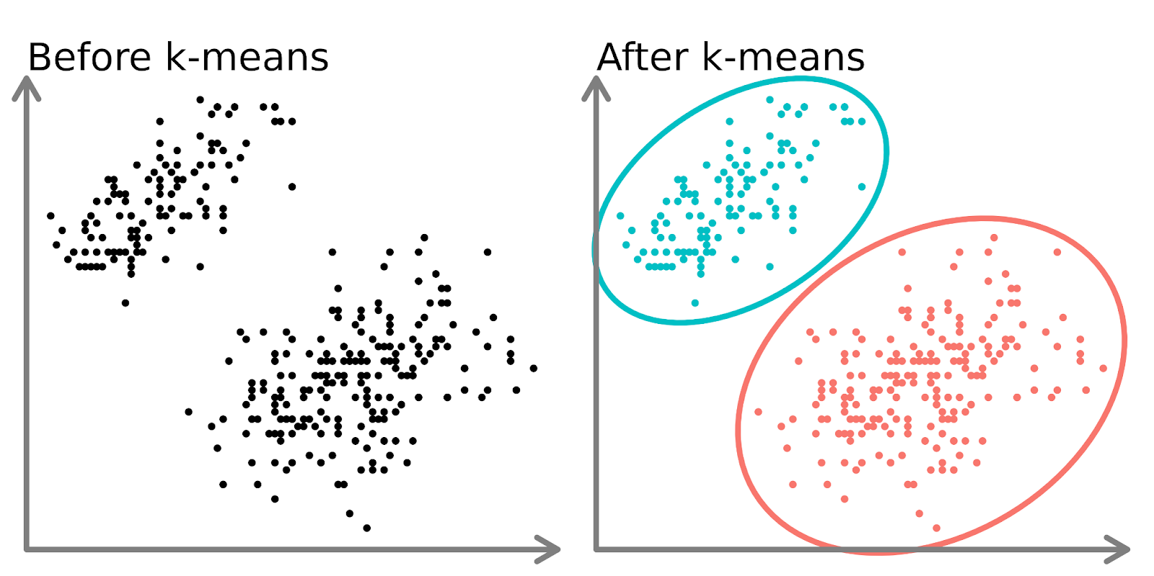
Overview of k-Means Clustering
K-means is a popular unsupervised machine learning technique that allows the identification of clusters (similar groups of data points) within the data.
Clustering models aim to group data into distinct “clusters” or groups. This can be used an analysis by itself, or can be used as a feature in a supervised learning algorithm.

Slide 4
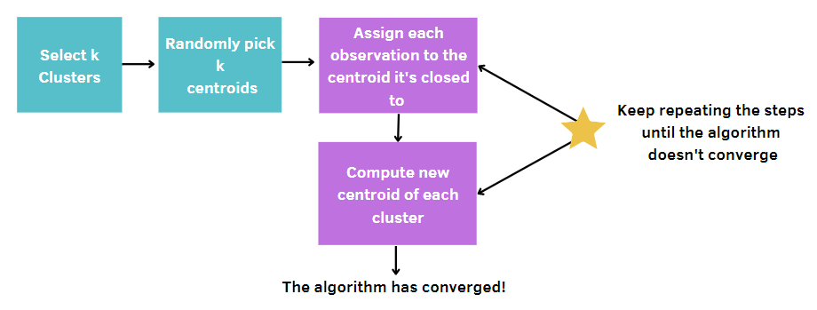
K-means algorithm (Contd.)
Choose the number of clusters, k.
Select k points (clusters of size 1) at random.
Calculate the distance between each point and the centroid and assign each data point to the closest cluster.
Calculate the centroid (mean position) for each cluster.
Keep repeating steps 3–4 until the clusters don’t change or the maximum number of iterations is reached.

Slide 5
K-medoid clustering algorithm
K-Medoids is an unsupervised machine learning clustering algorithm resembling the K-Means clustering technique.
It majorly differs from the K-Means algorithm in terms of the way it selects the clusters‟ centres.
The former selects the average of a cluster‟s points as its centre (which may or may not be one of the data points) while the latter always picks the actual data points from the clusters as their centres (also known as medoids).
K-Medoids also differs in this respect from the K-Medians algorithm which is the same as K-means, except that it chooses the medians (instead of means) of the clusters as centres.
The mean in k-means clustering is sensitive to outliers. Since an object with an extremely high value may substantially distort the distribution of data. Hence we move to k-medoids. Instead of taking mean of cluster we take the most centrally located point in cluster as it‟s center. These are called medoids.

Slide 6
K-MEDOIDS Algorithm
The steps followed by the K-Medoids algorithm for clustering are as follows:
1. Randomly choose k points from the input data (k is the number of clusters to be formed). The correctness of the choice of k’s value can be assessed using methods such as silhouette method.
2. Each data point gets assigned to the cluster to which its nearest medoid belongs.
3. For each data point of cluster i, its distance from all other data points is computed and added. The point of ith cluster for which the computed sum of distances from other points is minimal is assigned as the medoid for that cluster.
4. Steps (2) and (3) are repeated until convergence is reached i.e. the medoids stop moving.

Slide 7
Advantages of the technique
Mean of the data points is a measure that gets highly affected by the extreme points.
So in K-Means algorithm, the centroid may get shifted to a wrong position and hence result in incorrect clustering if the data has outliers because then other points will move away from.
On the contrary, a medoid in the K-Medoids algorithm is the most central element of the cluster, such that its distance from other points is minimum.
Since medoids do not get influenced by extremities, the K-Medoids algorithm is more robust to outliers and noise than K-Means algorithm.
The following figure explains how mean‟s and medoid‟s positions can vary in the presence of an outlier.

Slide 8
K-Medoids
What is the difference between K-means and K-medoids clustering?
K-means selects the average of all the cluster points as its center( which may or may not be one of the data points), while K-medoids always pick an actual data point as the cluster's center.
K- means attempts to minimize the total squared error. In contrast, K-medoids attempt to minimize the sum of dissimilarities between the points labeled in the cluster and the cluster's center.
What are the advantages of the K-medoids algorithm?
K- medoids algorithm is robust to outliers and noise as the medoids are the most central data point of the cluster, such that its distance from other points is minimal.
K-Medoids algorithm can be used with arbitrarily chosen dissimilarity measures (e.g., cosine similarity) or any distance metric.
What are the drawbacks of the K-medoids algorithm?
The K-medoids algorithm has large time complexity. Therefore, it works efficiently for small datasets but doesn't scale well for large datasets.
The K-Medoid algorithm is not suitable for clustering non-spherical (arbitrary-shaped) groups of objects.

Slide 9
Examples
Use dataset – dataset.csv
Use Kmeans and Kmedoid to cluster our customers into buying groups based on their Annual Income and Spending Scores
Compare the same

Slide 10
Exercise
Use dataset – Mall_Customers
Mall Customer data is an interesting dataset that has hypothetical customer data. It puts you in the shoes of the owner of a supermarket.
Use Kmeans and Kmedoid to cluster our customers into various groups based on the data available
Compare the same

